Slide 1
Introduction
#1

Slide 2
Computers
Where do they come from?

Slide 3
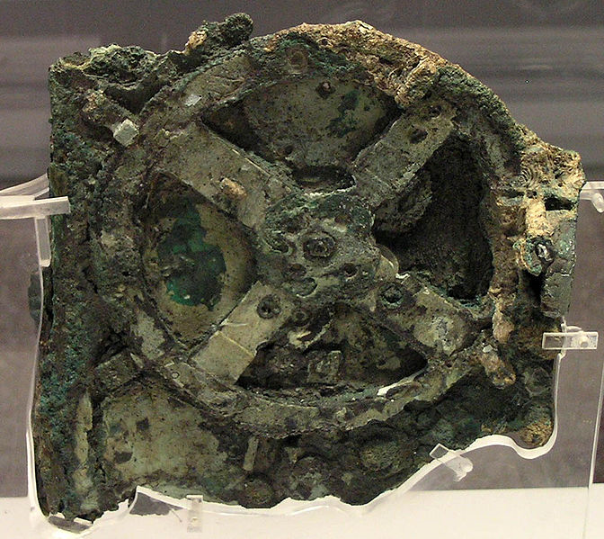
They are old!
The Antikythera Mechanism
Thousands of years old
Late second/early first century BC
That’s like -100 ish
Used for astronomy
Eclipses
Astronomical positions

Slide 4
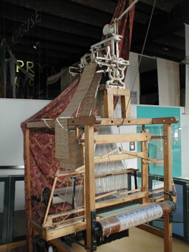
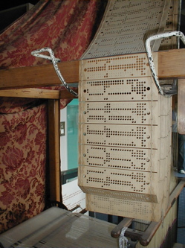
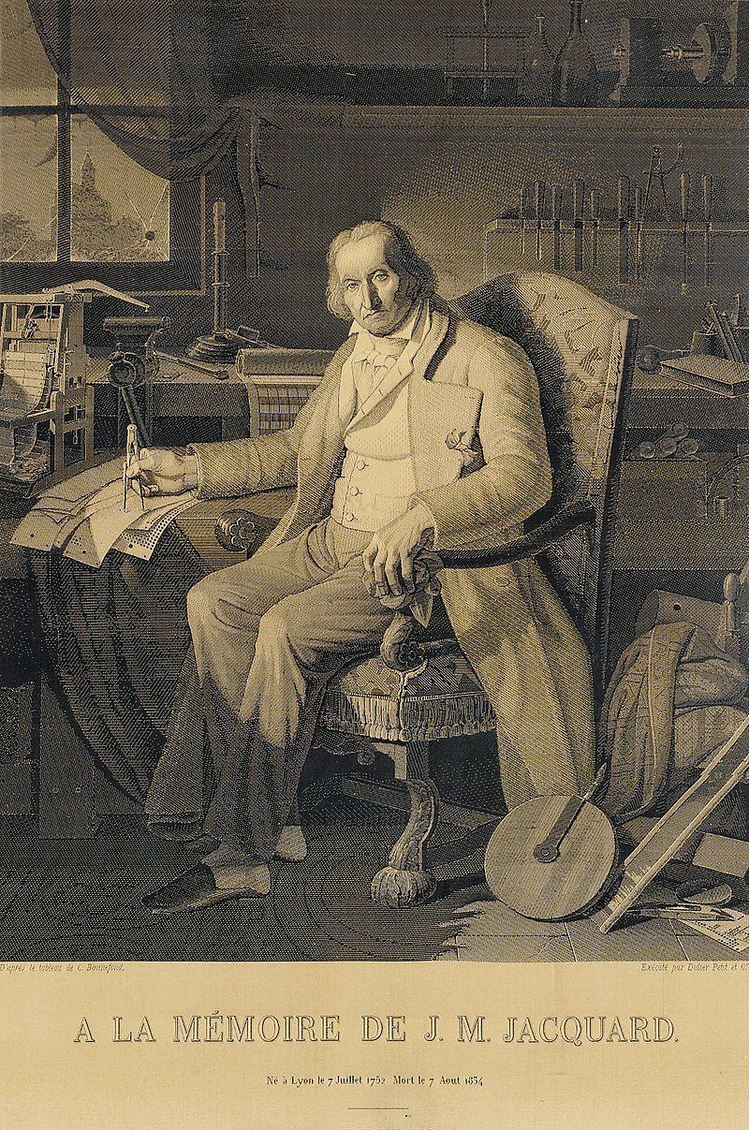
They are not (ALL) war machines
Jacquard machine
Mechanical loom (1804)
Programmed using perforated cards
Used to produce complex patterns
Woven in silk using 24k punch cards!

Slide 5
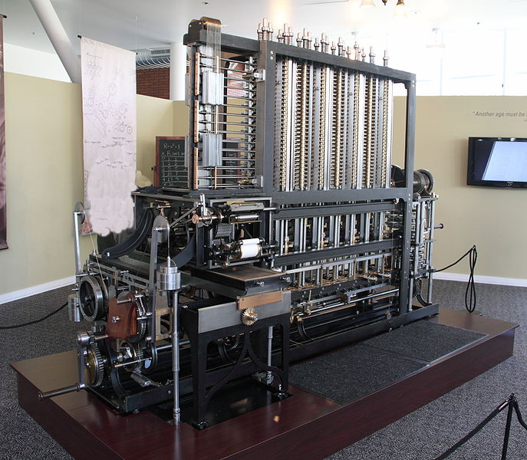
The pre-history of computers
The Differential Engine
Designed by Charles Babbage
1792-1871
Ermmm… Designed… right!
It was intended as a programmable calculator
A multipurpose calculator!

Slide 6
The pre-history of computers
The Differential Engine
Devised by J.H. Müller in the Hessian army (1784)
Designed by Charles Babbage (1819-ish)
Built at Science Museum library in London (1980s)
Outputs to a table that can be used for printing
Copying was a source of error
It still is nowadays
So never copy results manually if you can avoid it

Slide 7
The pre-history of computers
The Analytical Engine
Designed by Charles Babbage
YES! Designed… again!
Mechanical general-purpose computer
Which had many modern characteristics
No actual picture because… it was never built

Slide 8
The pre-history of computers
The Analytical Engine
It already included the essential ideas of modern computers
Inputs and outputs
Execution of operations
Automatic control of operation
However, due to its complexity (lack of funding) it was never built
And the fact that new features were constantly being added!
And old features were never completed
Does this sound familiar? It will, it will! ☺

Slide 9
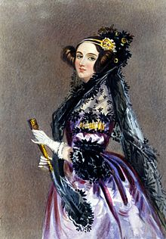
“The Enchantress of Numbers” - the first programmer
Augusta Ada King, Countess of Lovelace
Wrote algorithms for this computer →
Yeah, that one!
But they probably would have worked
Translating a paper, she added notes
A LOT of notes
More than the actual paper
Including instructions on how to calculate a number series
Note G
Studied the relation between maths and music

Slide 10
Part of note G
The Analytical Engine has no pretensions (…) to originate anything. It can do whatever we know how to order it to perform. It can follow analysis; but it has no power of anticipating any analytical relations or truths.

Slide 11
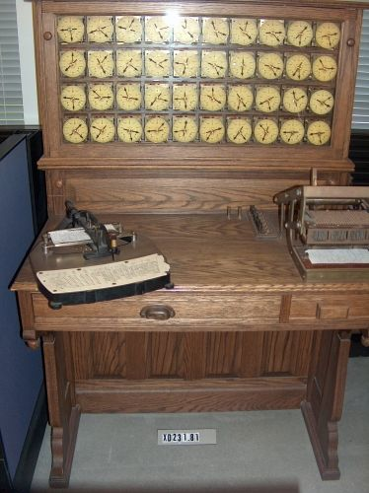
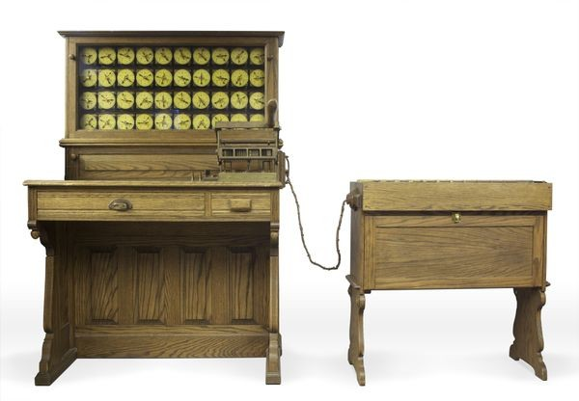
The pre-history of computers
(replica)
Hollerith Electric Tabulating System
Census happen every 10 years
Hey, they just did!
It took people 8 years to count responses (in 1880)
It would soon take more than 10!
7,000 cards a day using this system
Company would become IBM
After a merge with others
https://www.computerhistory.org/revolution/punched-cards/2/2/5

Slide 12
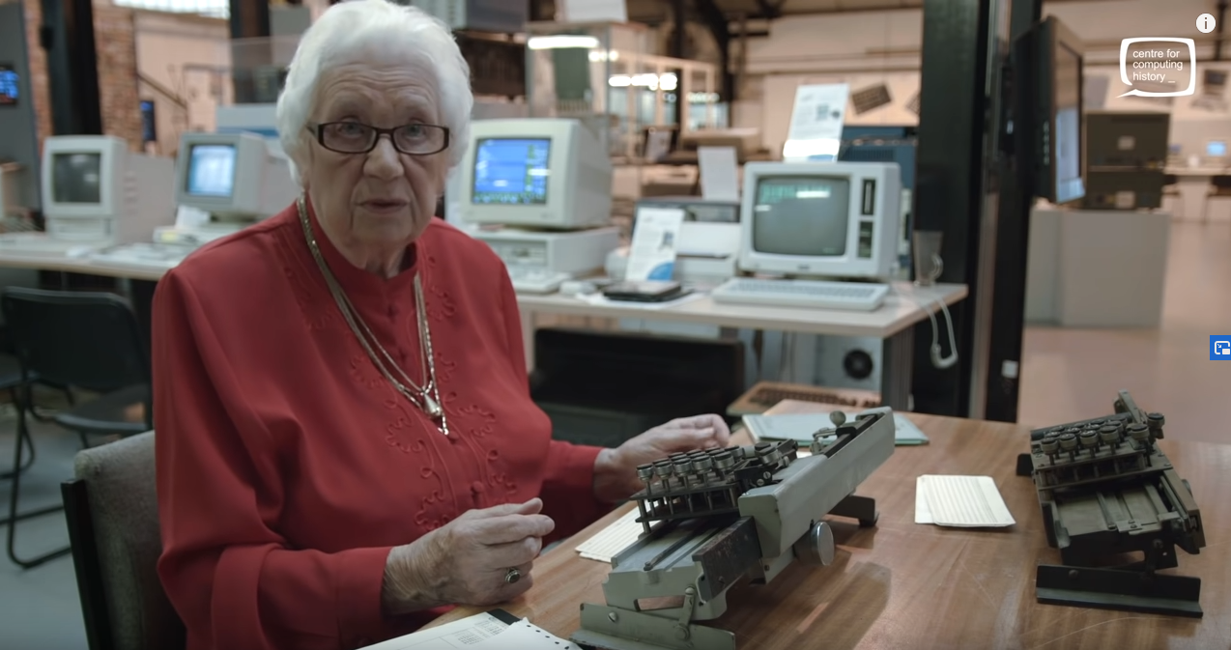
Bubbles
Check what Bubbles has to say about it ☺
https://www.youtube.com/watch?v=L7jAOcc9kBU

Slide 13
Driven by the need for complex calculations
https://computerhistory.org/blog/first-steps-lectures-from-the-dawn-of-computing/
George Stibitz (Bell Labs)
Day-job: Electrical engineer
Model K – binary addition with relays (Boolean algebra)
Complex Number Computer – used remotely via telegraph lines!!
Art with Amiga (1990s) - http://stibitz.denison.edu/art.html
Konrad Zuse (Germany)
Day-job: Aircraft designer (civil engineer)
World's first programmable computer
Several computers used for military calculations
John Atanasoff (Iowa State)
Day-job: Physics professor
Built the ABC (Atanasoff-Berry Computer)
solved 30 equations in 30 unknowns

Slide 14
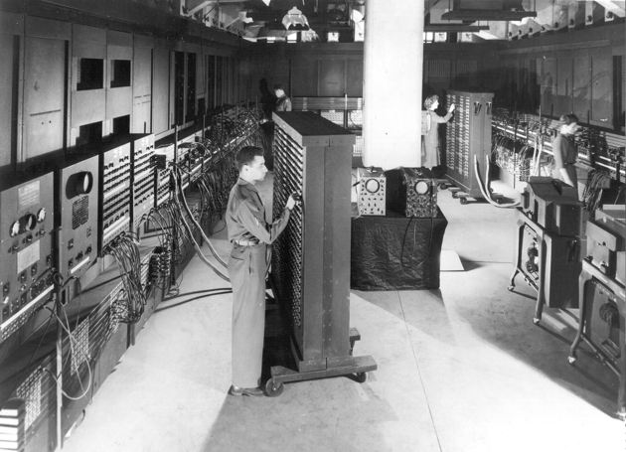
The first “modern” computers
ENIAC (Electronic Numerical Integrator and Computer)
1946 – ENIAC
University of Pennsylvania
Developed during WWII to calculate balistic missile trajectories
Designed by :
John Mauchly
J. Presper Eckert
Joined by a huge team!
Modular and reconfigurable
Flipping switches and connecting cables
U. S. Army Photo

Slide 15
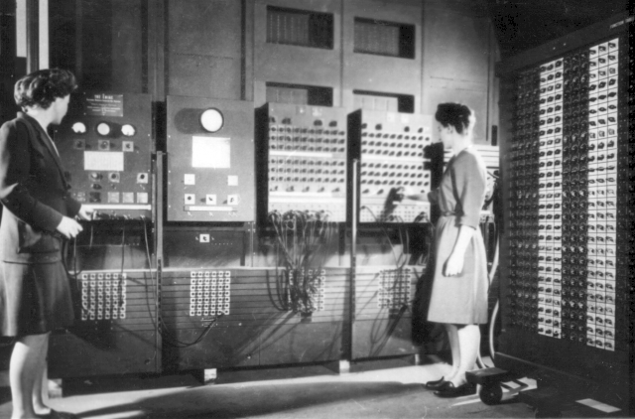
ENIAC (Electronic Numerical Integrator and Computer)
Some numbers:
18000 valves (tubes)
1500 relays
30 tons
175 kW
5000 additions / s
357 multiplications / s
40 divisions / s
Programs "hardwired"
U. S. Army Photo

Slide 16
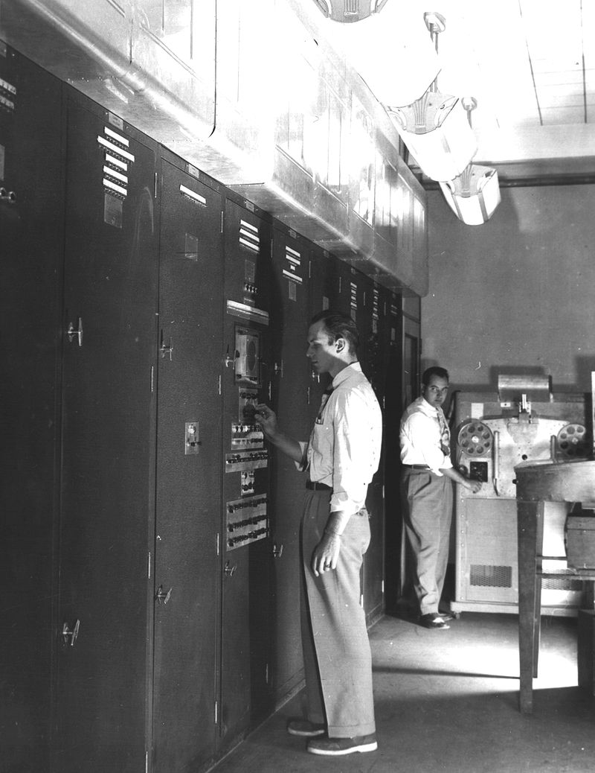

The first “modern” computers
EDVAC (Electronic Discrete Variable Automatic Computer)
1947 – EDVAC
University of Pennsylvania
The ENIAC team joined by John Von Neumann
A computer with a new concept:
"Memory Stored Program" – same as data
Became operational in 1951
U. S. Army Photo

Slide 17
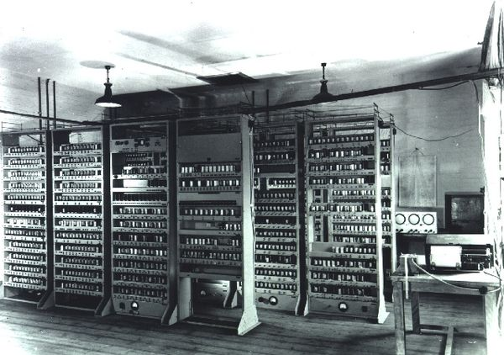
The first “modern” computers
EDSAC (Electronic Delay Storage Automatic Calculator)
1949 – EDSAC
Cambridge University
Designed by Maurice Wilkes
Based on the first EDVAC draft
Not to be better, but to be used!
accessible and practical vs. push technology
Was completed before the EDVAC!
Used for scientific research
Chemistry, Medicine, Physics
https://en.wikipedia.org/wiki/EDSAC
https://www.tnmoc.org/edsac

Slide 18
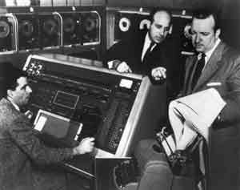
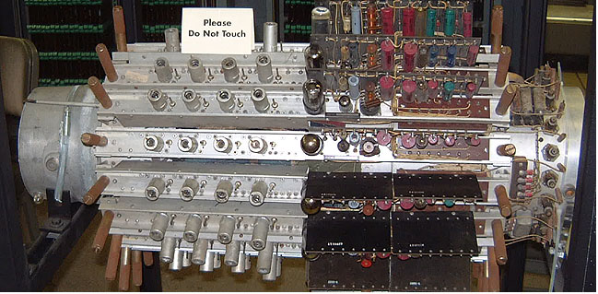
The first “modern” computers
UNIVAC (Universal Automatic Computer)
1951 – UNIVAC
First commercial computer!
Sold 46! Units
Used to predict the 1952 presidential election
Used MERCURY!! memory (as did the EDSAC)
Delay Storage
https://en.wikipedia.org/wiki/Delay_line_memory

Slide 19
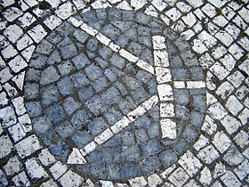
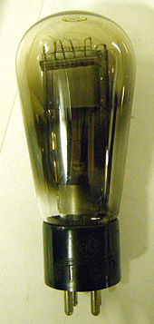
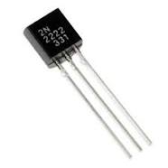
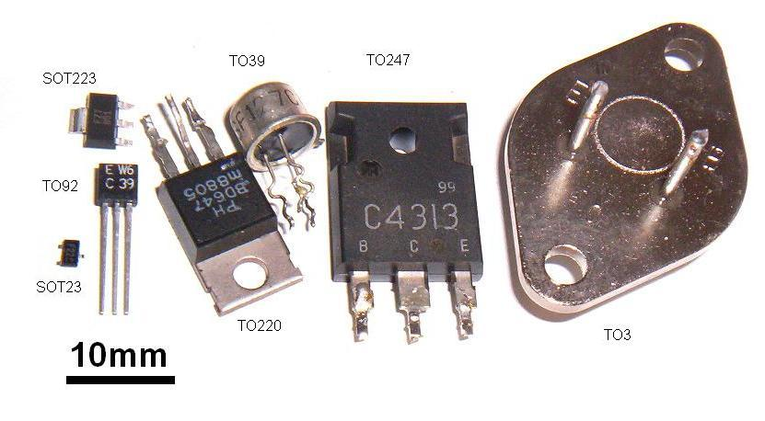
Then came the transistor
The symbol for a transistor
Photo taken in the university where I did my masters
They were tiny
Didn’t get HOT!
Didn’t break as often
https://en.wikipedia.org/wiki/Transistor

Slide 20
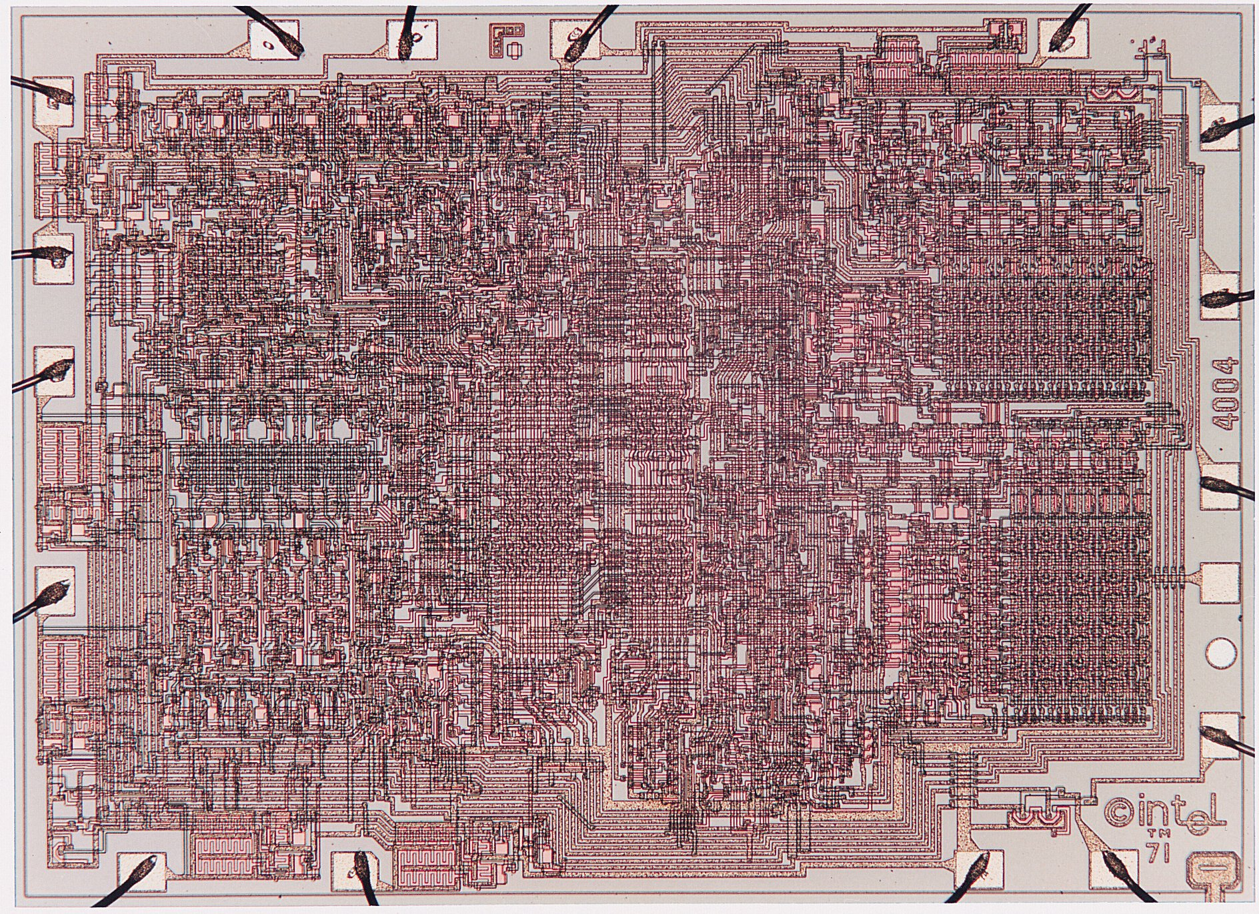
Then came the Integrated circuit
2300 of these in there
Things became tiny
More transistors could be fitted
Cheaper circuits
More affordable

Slide 21
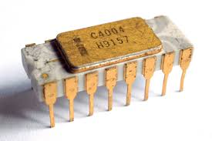
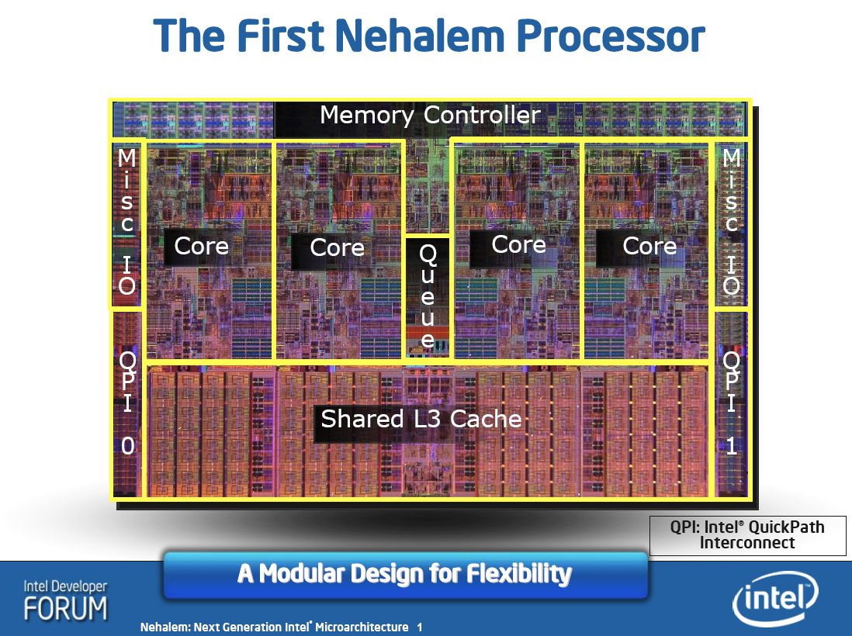
Extremely brief story of Intel CPUs
1971 – Intel 4004
4-bit microprocessor
with 2300! Transistors
2004 – Pentium 4
x86 32-bit
125 Million transistors
2017 – Kaby Lake
x86_64 64-bit
>1000 Million! (undisclosed?)

Slide 22
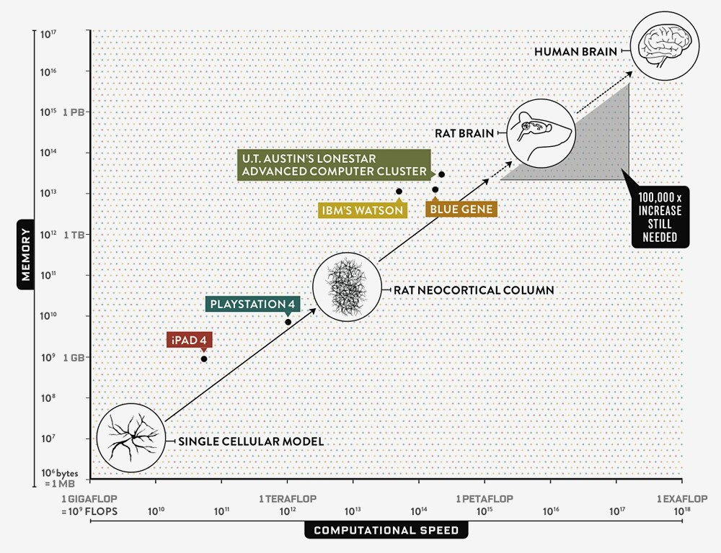
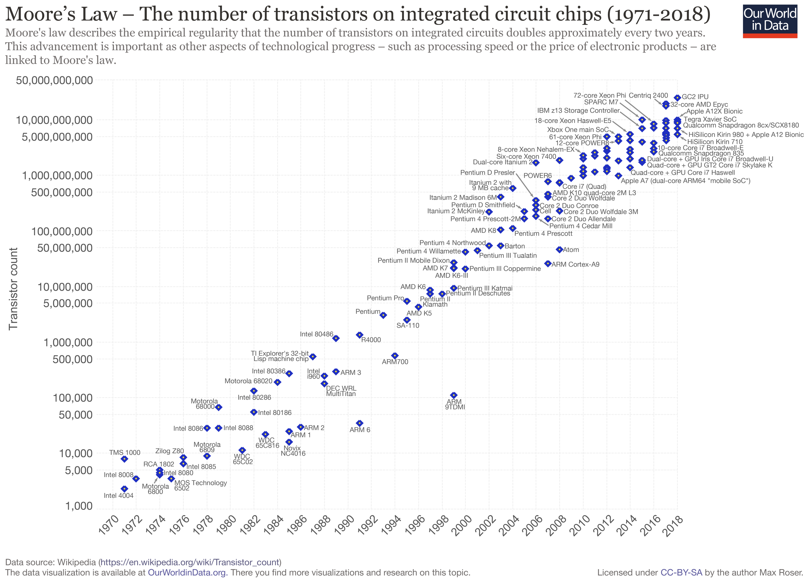
Moore’s Law
Illustration: https://www.wired.com/2013/05/neurologist-markam-human-brain/
82944 processors from a supercomputer
Where used to simulate
1s of human brain activity
In 40m

Slide 23
The Hardware
All different but all (mostly) the same

Slide 24
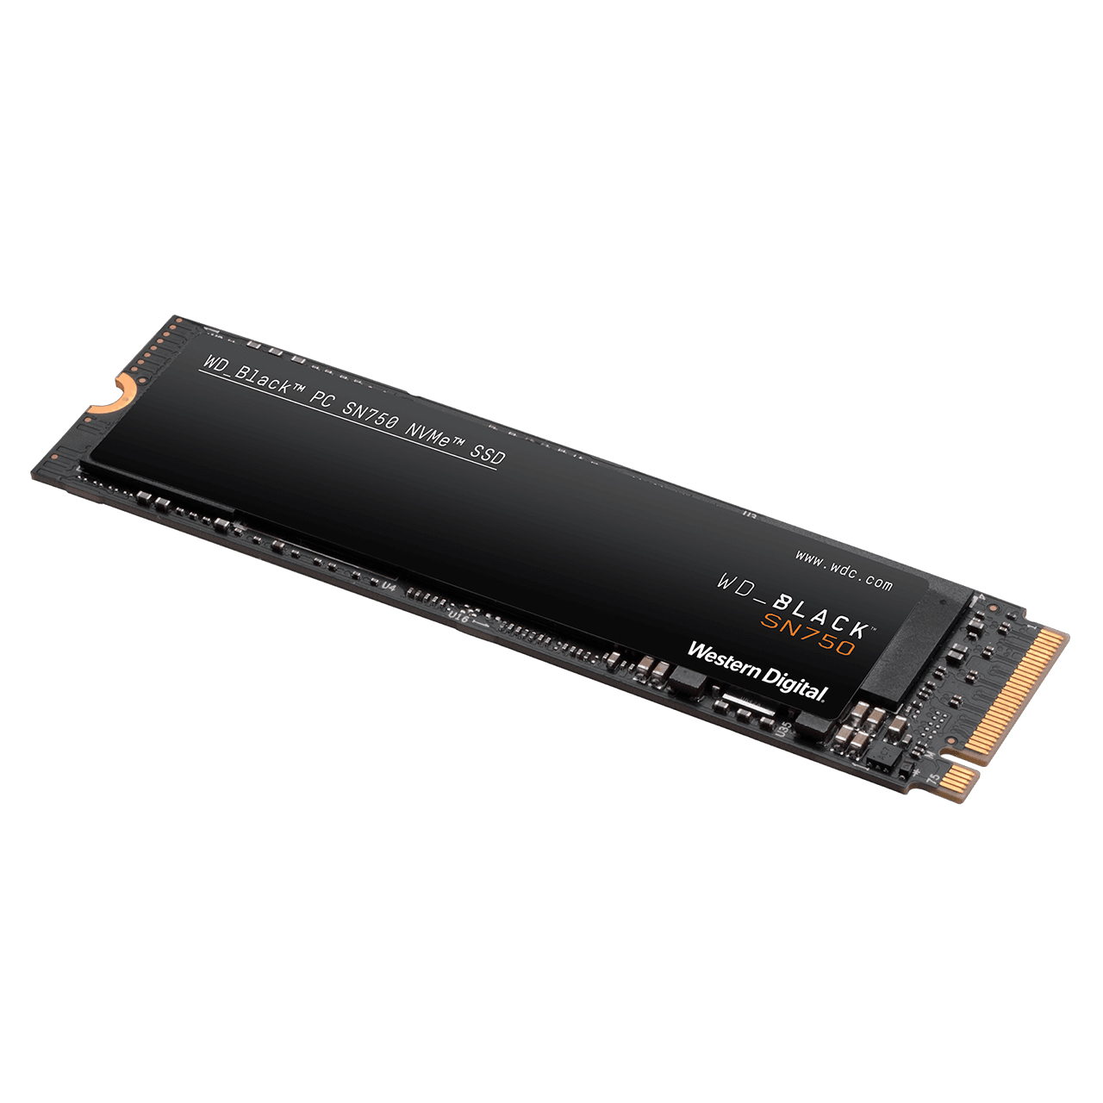
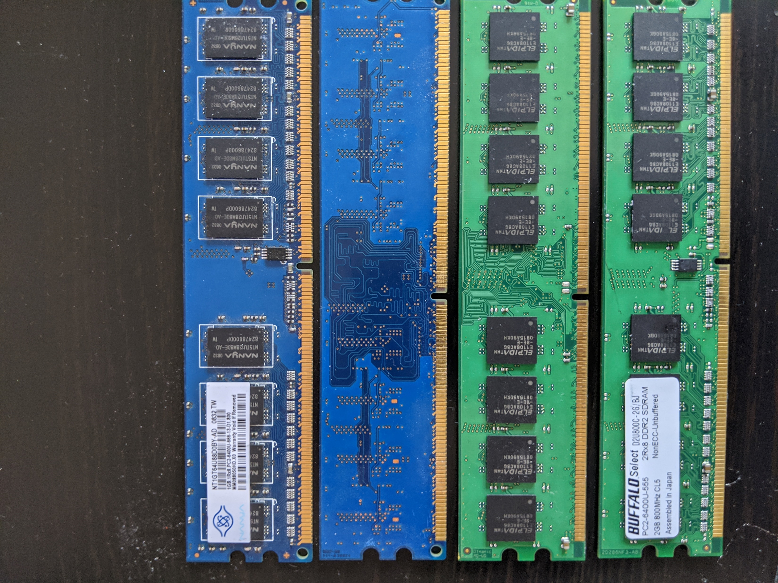
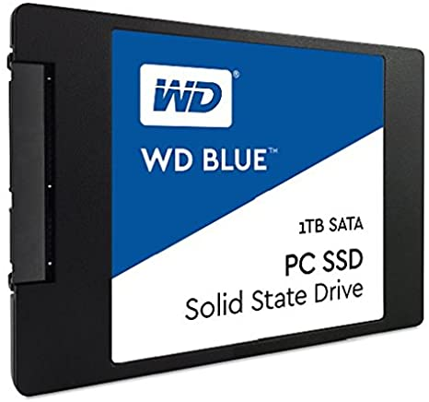
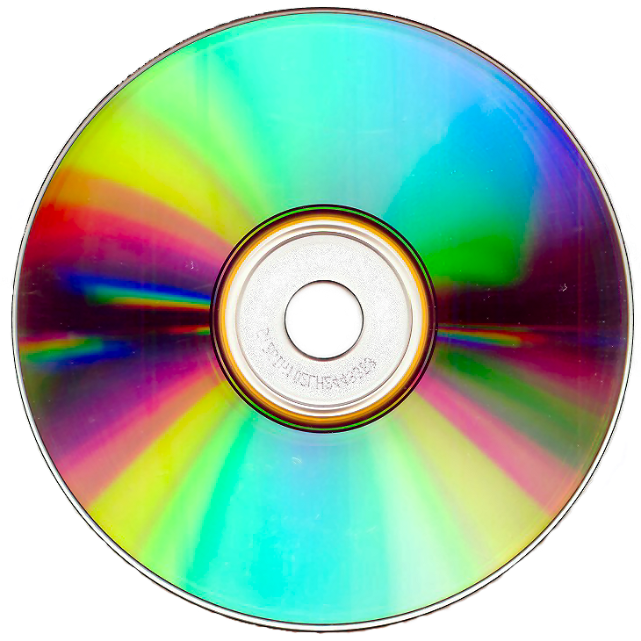
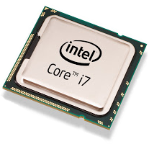
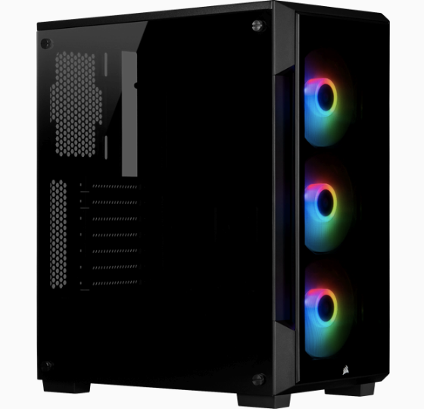
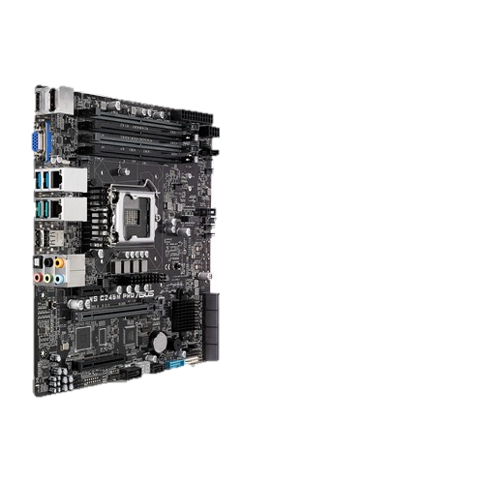
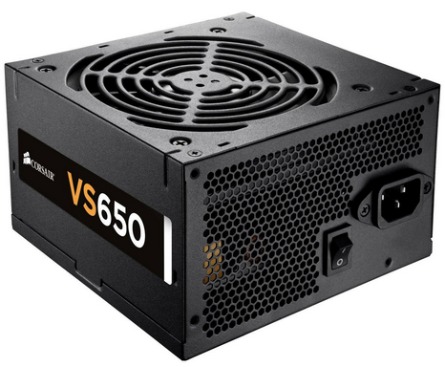
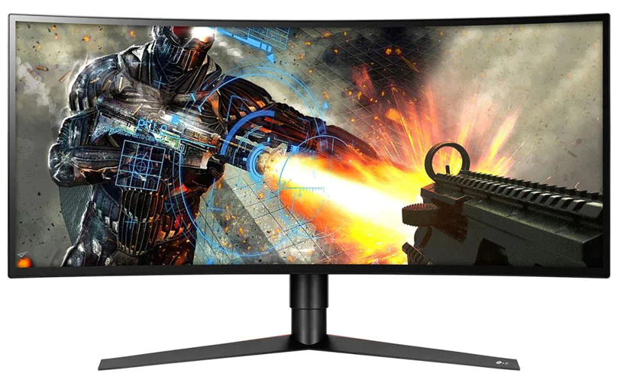
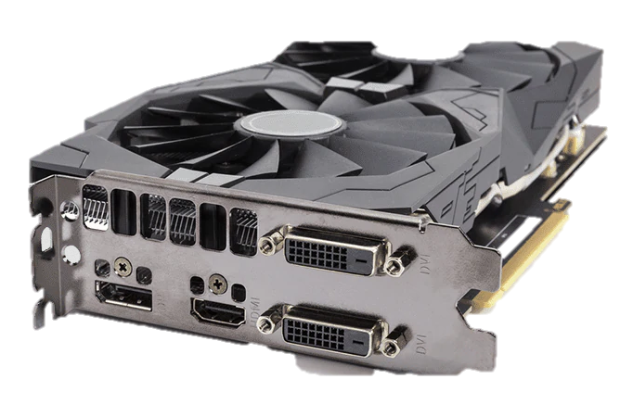
What hardware?
Main memory (RAM)
Central Processing Unit (CPU)
Secondary memory (Hard Drive, Solid State Drive, CD/DVD/BluRay)
Power Supply
Motherboard
Monitor
Graphics Card (Accelerators)

Slide 25
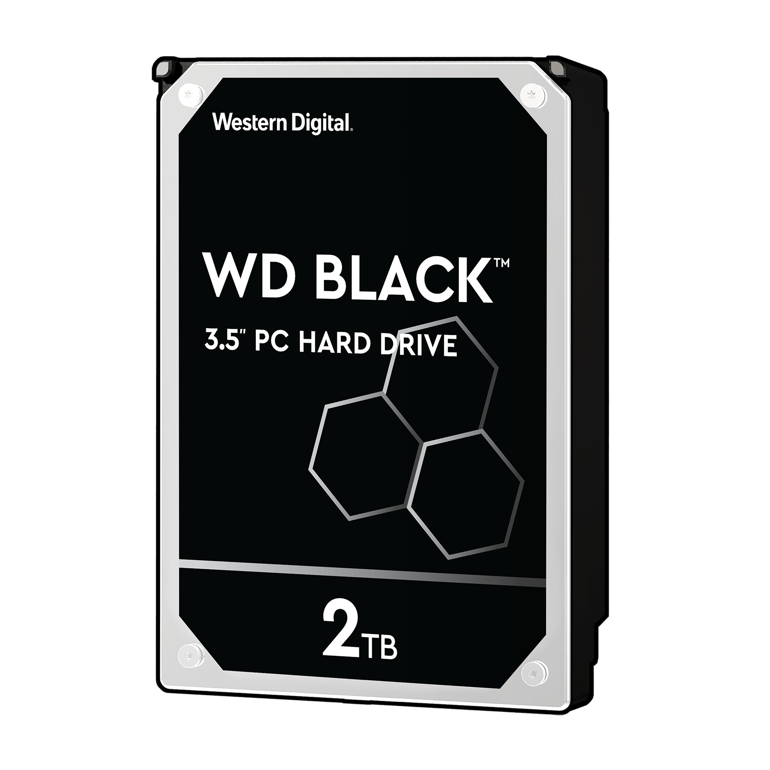
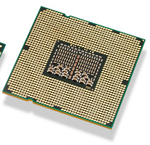
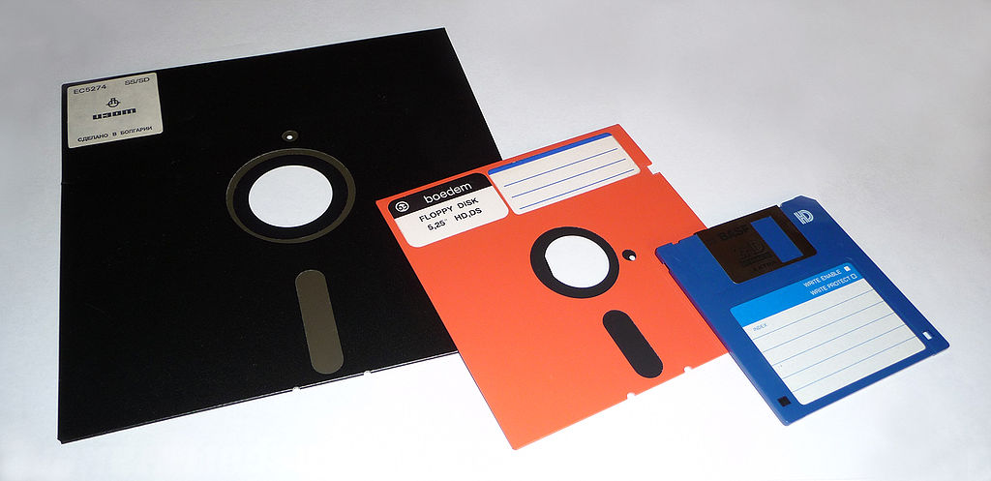
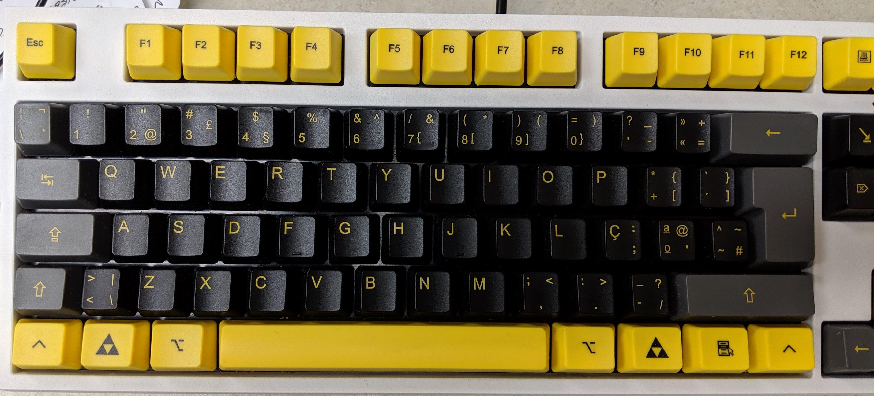
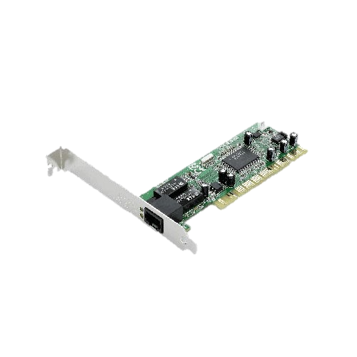
All connected
The Internet

Slide 26
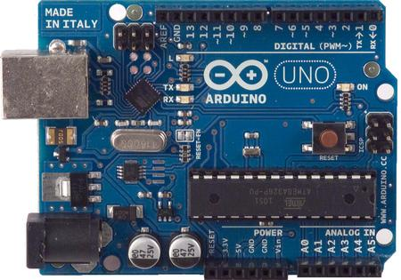
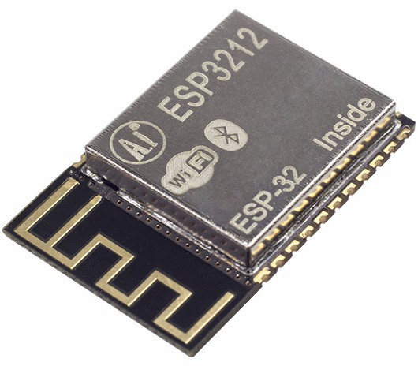
Some are small and cheap
They run a single program
E.g your refrigerator
Are used by hobbyists
For small projects

Slide 27
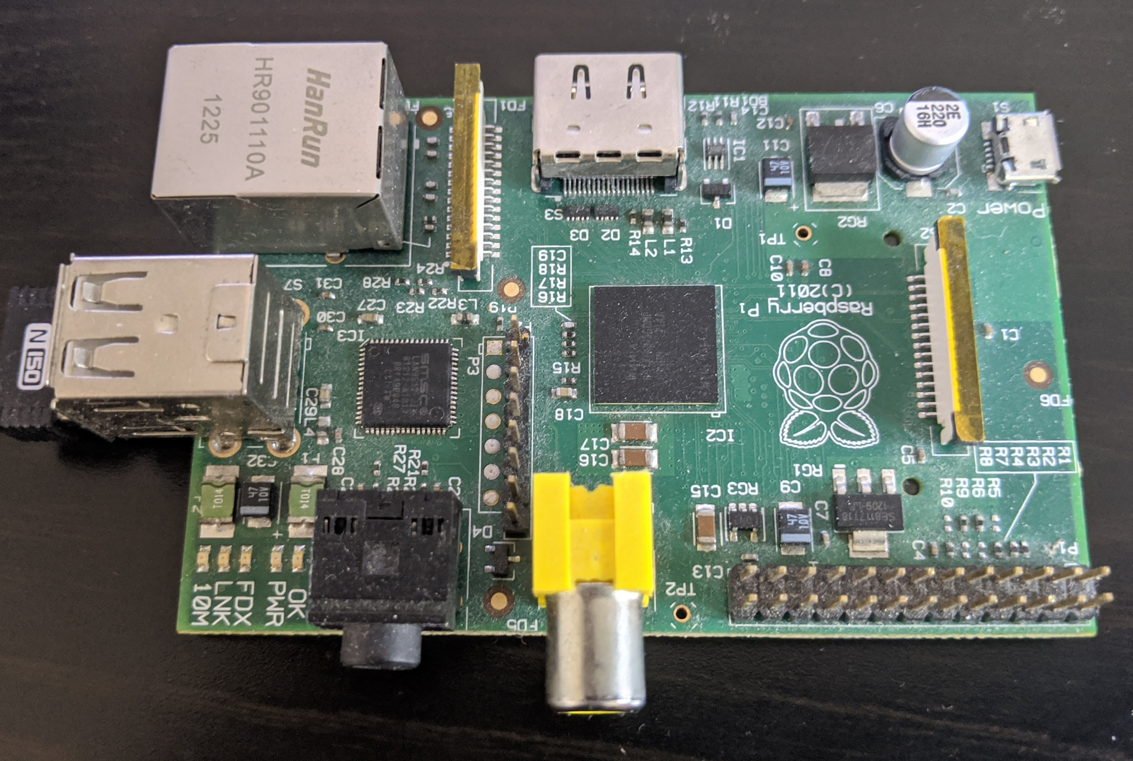
Some are small, cheap, and powerful
The Raspberry Pi
Affordable, yet powerful
~$35
Can be used for A LOT of projects
Home automation
Affordable PC
Great to learn how to program on a budget

Slide 28
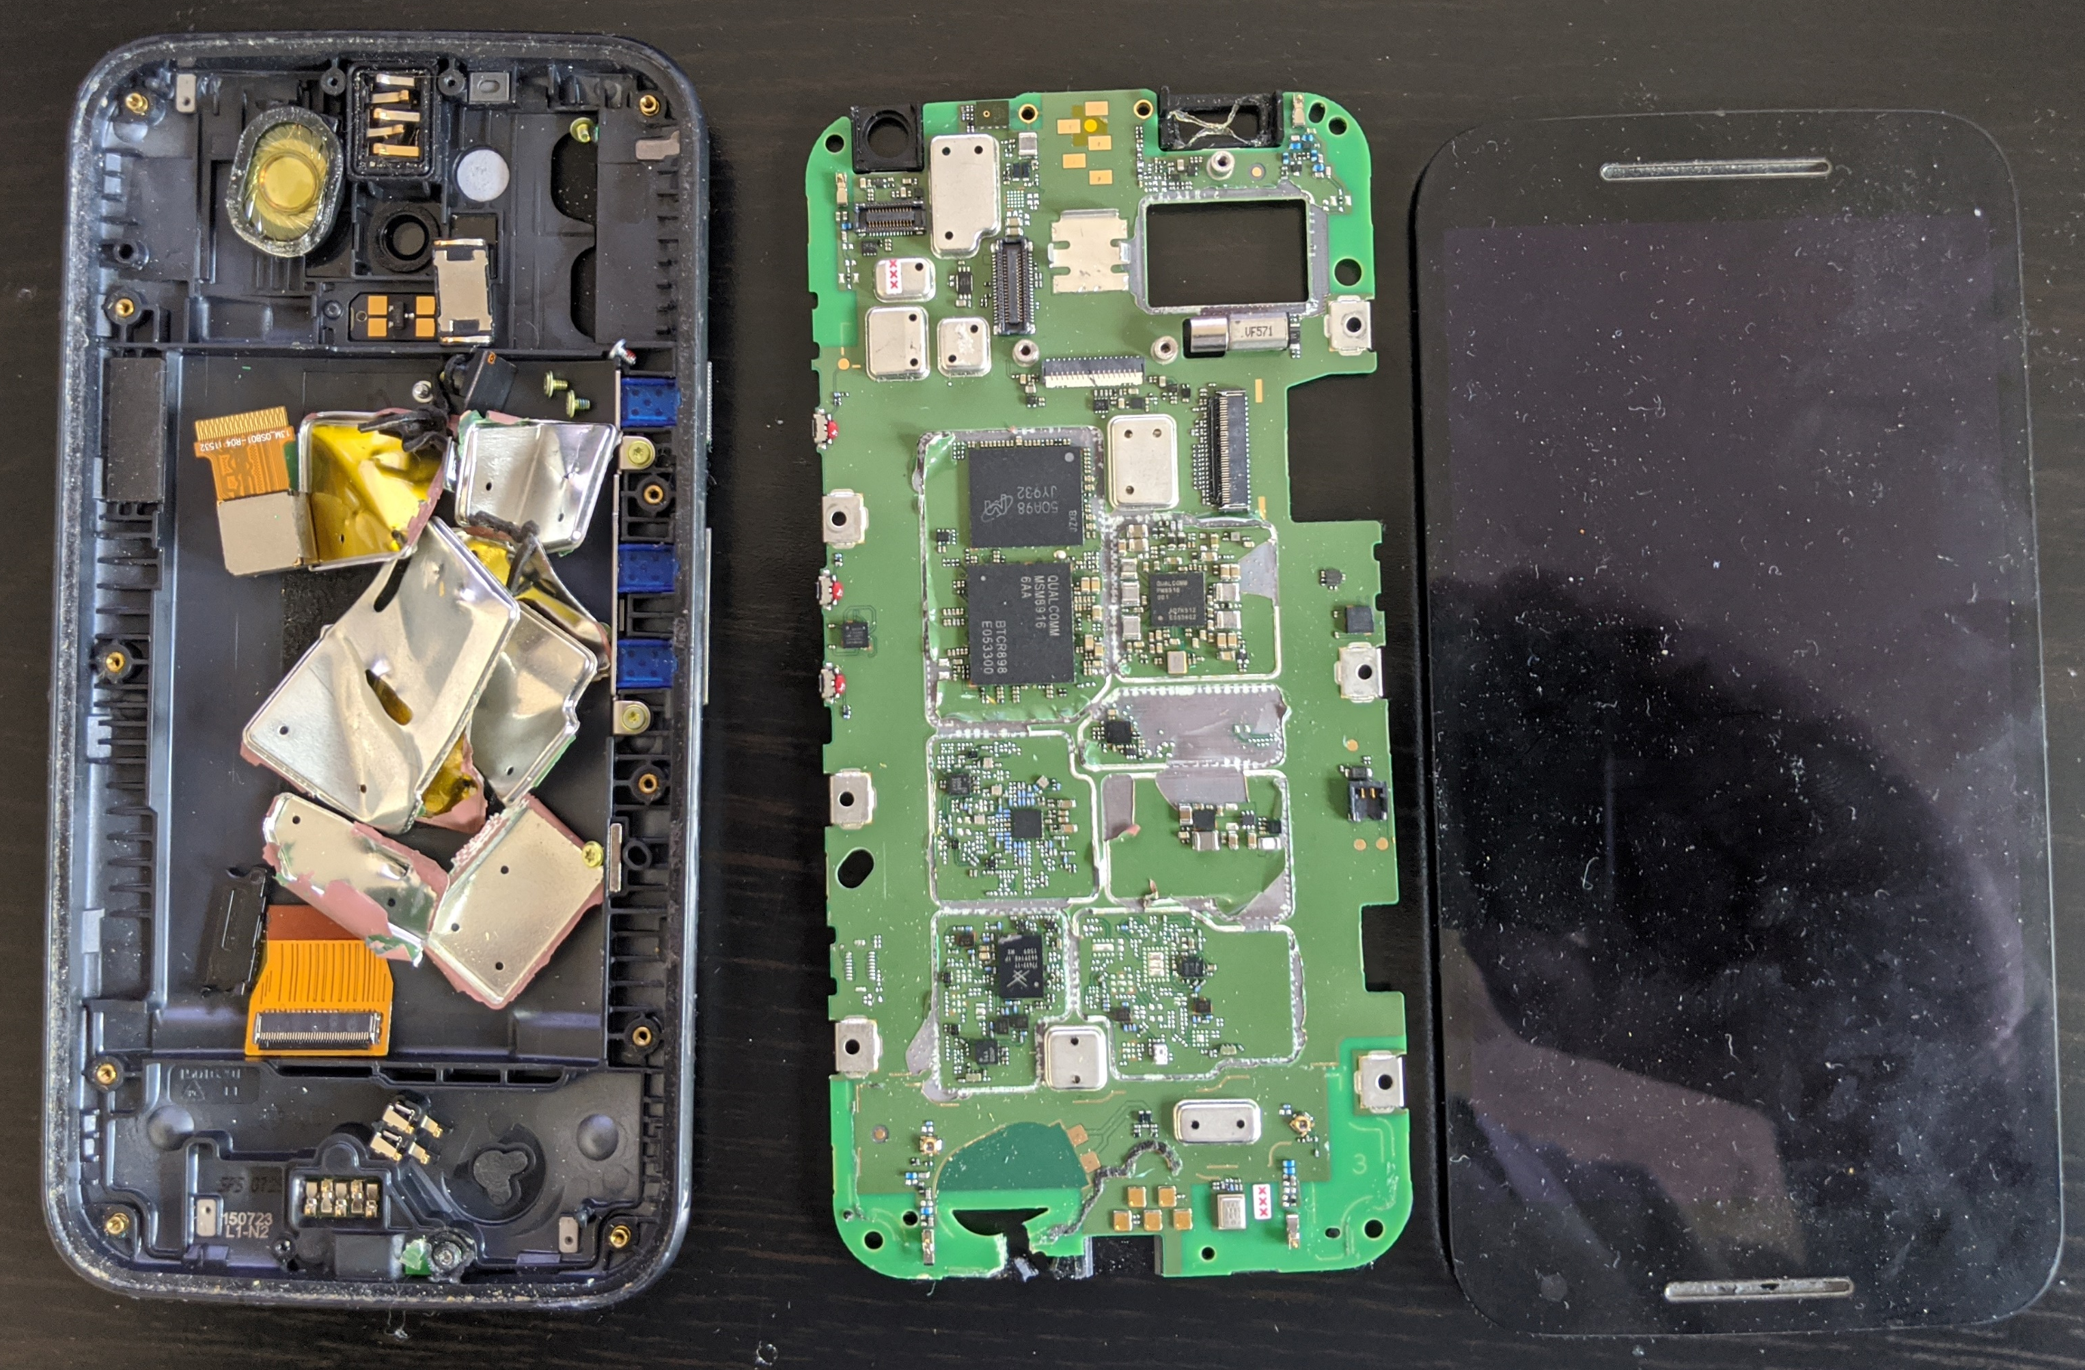
Some are small, expensive, and powerful
My Moto G3 ☹
I sacrificed it for you!
(battery was bloated, it had to go)
Had to rip some parts :D
Mobility is important (~1 day)
Portability is important
But it runs beefy apps!

Slide 29
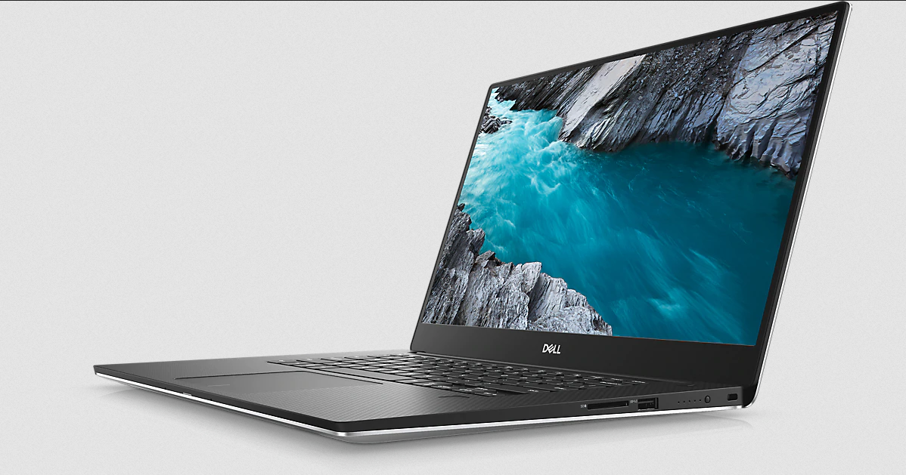
We hold them in our laps (does anyone do that often?)
Power and mobility
Battery life is important
We want to fly with them ☹
Weight is important
Run demanding programs!

Slide 30
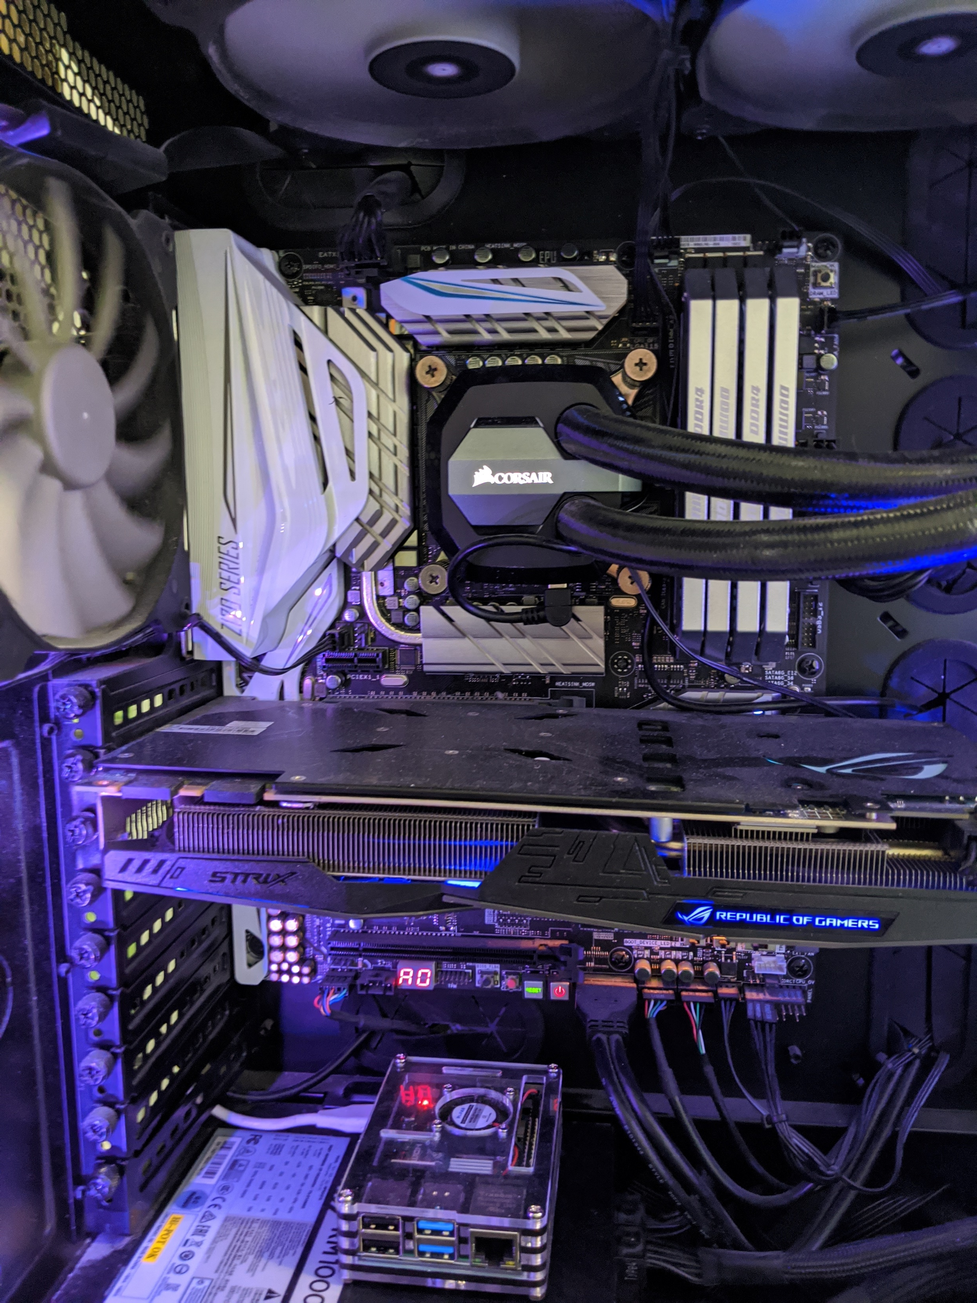
We have them at home
My computer
Desktop computers
Wide range of prices ($300 to +$5k)
Energy consumption not important
Beyond cost and heat generation
Performance
Games
Browsers!!
Word?
That’s a Raspberry Pi

Slide 31
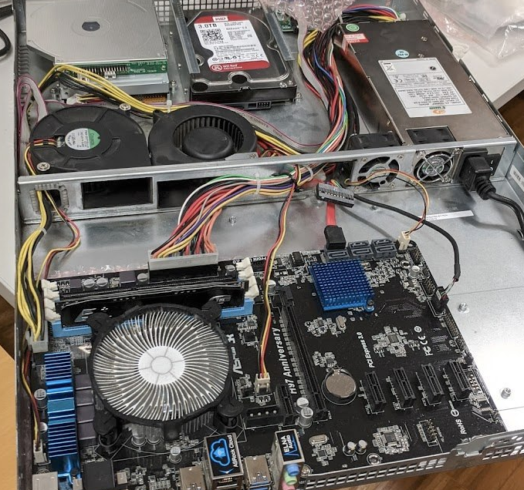
We have them in warehouses
Server on a “drawer” (rack)
Don’t have monitors
People don’t “use them” directly
Non-interactive
Crunch numbers and return results
Webpages
Remote storage (e.g., box)

Slide 32
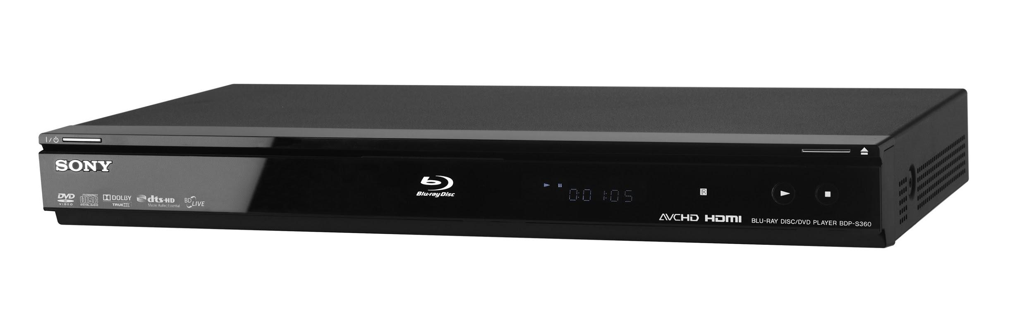
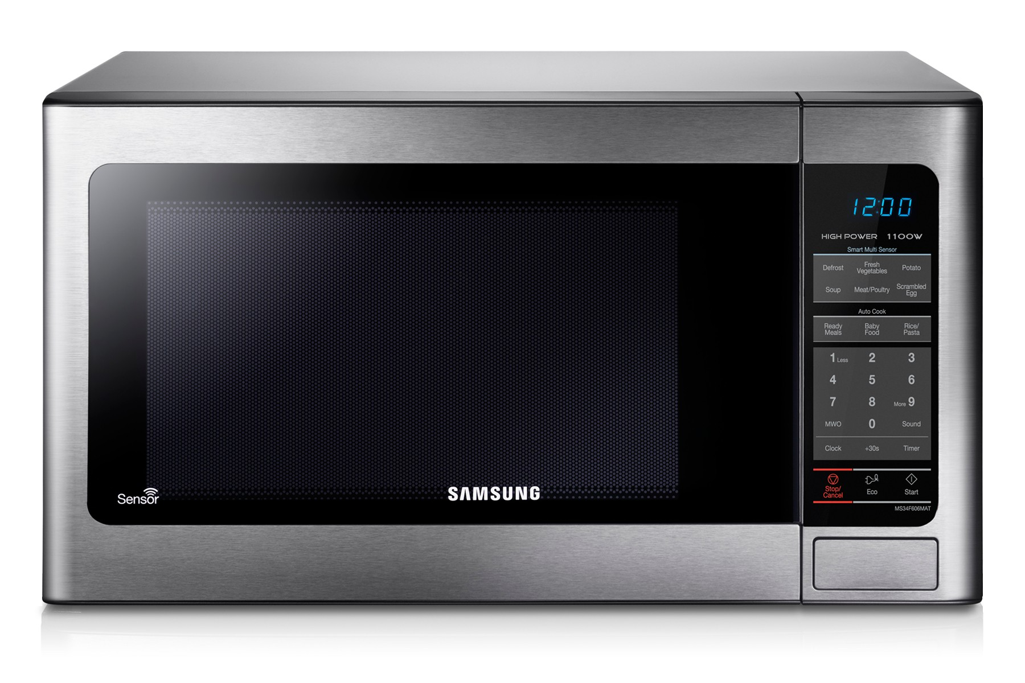
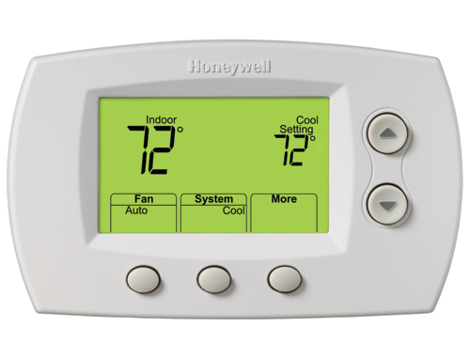
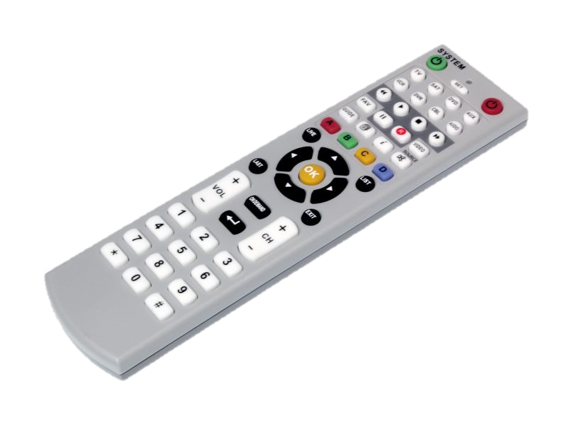





They come in all shapes and sizes

Slide 33
They look different, but follow the same principles
The Von Neumann architecture
Was developed for the EDVAC
CPU
Control → Reads code & manages execution
ALU -> Performs calculations on data
Memory
Contains information
The programs
The data
Inputs and outputs
Connect the computer and the world
Keyboards, Disk drives, monitors, etc.
Stored-Program Computer
Memory
Code what to do?
Data
CPU
Control Unit
Arithmetic Logic Unit
Input
Output

Slide 34

The Hardware is hard (ah!) to change
Once the circuits are made, there is not much you can change
It is still configurable and limited modifications are possible
Flipping switches and connecting cables (ENIAC) ☺
But what if we want to use the computer for something new?
We need something flexible!
Something soft (ah!) and mouldable
We need Software
Something the ENIAC programmers (the original computers) learned
Not “refrigerator ladies” → → → → → → → → → → → → →
Leading to the development of programming languages
Famously: Grace Hopper and Betty Holberton (COBOL and Fortran)
Top Secret Rosies: The Female "Computers" of WWII

Slide 35
The Software
Why do we want to program?

Slide 36


How useful?
Many accessories
1 accessory

Slide 37


Machine with a single function
Data in
Data out

Slide 38
We want computers to do different things
Computers are useful in many situations
Because they are programable!
Computers can run different programs
Program: A set of instructions that tell the computer what to do
Computers are not very smart actually, they do what programs tell them
Examples of software:
Windows, OSX, Linux – Operating Systems (OS) that manage your computer
Word, Firefox, Animal Crossing – Applications ran by the user

Slide 39



Programmable machine
Data in
Data out

Slide 40
How a program runs
Program
Program

Slide 41

How a program runs
Program
Fetch
Read from memory the next instruction (code)
I.e., what is next thing to do
Decode
What does the instruction want me to do?
E.g., I want to add two numbers (A and B)
Execute
Do the operation
E.g. add
Repeat
instruction
3
5
8
A
B
C
+
c=a+b

Slide 42

But how do we do it?
To program a computer we must learn to speak (one of) its language(s)
But importantly, we need to learn how to program.
What’s the difference?
Know words you do, right? ☺
But can you write a 1000 pages novel?
We’ll aim a bit lower, maybe a couple of 100 pages?

Slide 43
Good news!!!
The Java language uses patterns very similar to other languages
That’s because those patterns serve programmers well.
Other languages are not the same!
But they will be similar enough
Once you learn those patterns, picking up a different language is easier
Why would you?
Would you use an atomic bomb to kill a fly?

Slide 44
Compute speak
x=x+1
CPU 449
Java 0007
C 0449
Python 0010/9?
lw $t0, x addi $t0, $t0, 1 sw $t0, x
CPU 447
10011101100110011001111101111001 10111100000010011001111101111001
11011110110010111011101001111001
10011100100110110001101111111011

